Slide 1


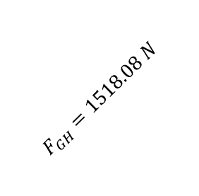
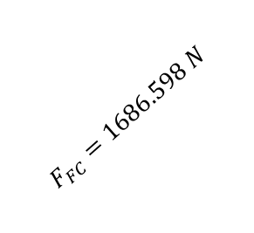


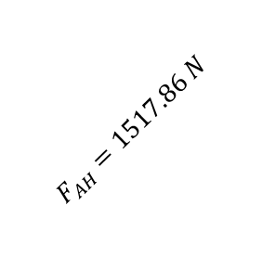


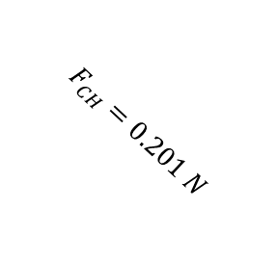
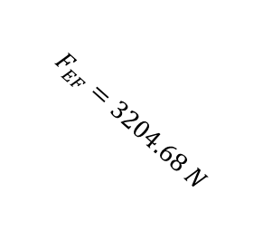


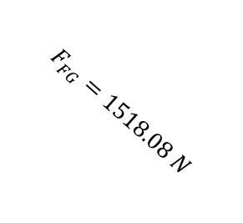


G
43.36
$$F_{GH}=1518.08 N$$
$$F_{FG}=1518.08 N$$
H
F
$$F_{GC}=2207.45 N$$
43.36
43.36
43.36
$$F_{CH}=0.201 N$$
$$F_{FC}=1686.598 N$$
43.36
$$F_{AH}=1517.86 N$$
$$F_{EF}=3204.68 N$$
$$F_{BH}=0 N$$
$$F_{DF}=2452.5 N$$
43.36
A
46.64
46.64
46.64
46.64
$$F_{AH}=0 N$$
E
B
C
D
$$F_{AB}=1042.13 N$$
$$F_{CB}=1042.13 N$$
$$F_{DC}=2200.27 N$$
$$F_{DE}=2452.5 N$$
50×2×9.81 N
50×5×9.81 N
$$F_{AV}=1103.67 N$$
$$F_{EV}=2329.98 N$$

Slide 2
A
E
B
C
D
981 N
2452.5 N

